Slide 1
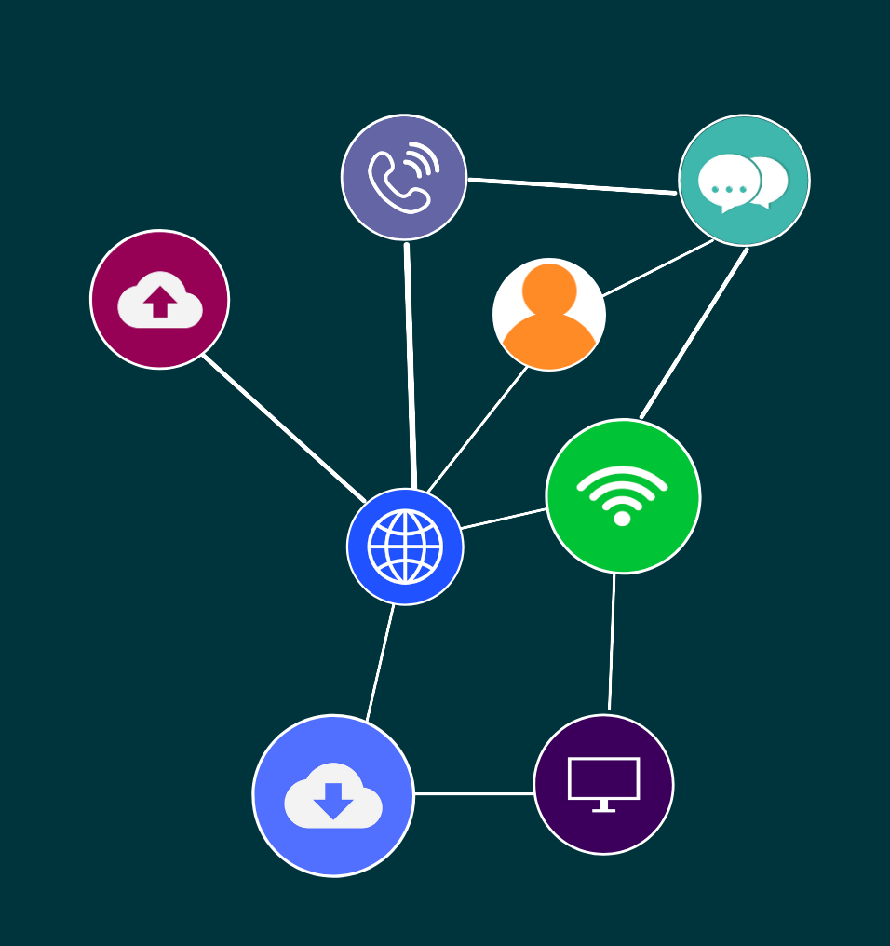

ICTTEN622
Produce ICT network architecture designs

Slide 2

‹#›
Topic 1: Preparing an ICT architecture design
© 2022 Milestones International College

Slide 3
‹#›
INTRODUCTION
ICT network architecture designs are vital for an effective and network system.
An ICT network architecture design generally includes:
A map of the network
Details of the cabling required
The number, type and location of all network devices
The IP addressing structure
Details of the network security architecture and processes
Topic 1: Preparing an ICT architecture design
Topic 1: Insert topic title
© 2022 Milestones International College

Slide 4
‹#›
NETWORK TECHNOLOGIES
Access networks
Core networks
Network topologies
Mobile cellular networks
Network protocols and operating systems
Optical networks and principles
Radio frequency (RF) technologies and principles
Topic 1: Preparing an ICT architecture design
Topic 1: Insert topic title
© 2022 Milestones International College

Slide 5
‹#›
WORK DETAILS, SPECIFICATION AND SCOPE
Full information about the client’s requirements must be sourced and understood.
This can be at a strategic and operational level.
Topic 1: Preparing an ICT architecture design
Topic 1: Insert topic title
© 2022 Milestones International College

Slide 6

‹#›
ACTIVITY: RESEARCH AND DISCUSS
Work in small groups and outline the desktop applications and operating system being used in your classroom or at the closest ICT lab or facility.
Discuss your findings.
Topic 1: Preparing an ICT architecture design
© 2022 Milestones International College

Slide 7
‹#›
ACTIVITY: RESEARCH AND DISCUSS
An example problem statement:
The organisation has connectivity and performance issues, creating issues with production and disengaged employees.
What further information would you need to ask the client to gain a full understanding of their requirements?
Topic 1: Preparing an ICT architecture design
© 2022 Milestones International College

Slide 8
‹#›
SITE ACCESS
If you need to visit a client’s site there are some requirements that you should know about. This includes knowing about legislation, standards, regulations, procedures and codes of practice.
Topic 1: Preparing an ICT architecture design
Topic 1: Insert topic title
© 2022 Milestones International College

Slide 9
‹#›
REVIEWING SPECIFICATIONS AND REQUIREMENTS
Once the specifications and requirements have been obtained from the client then it must be reviewed to identify the type of ICT network and network specifications required.
Topic 1: Preparing an ICT architecture design
Topic 1: Insert topic title
© 2022 Milestones International College

Slide 10
‹#›
ACTIVITY: READ
The following example for the university of York is a requirements document for project managers and contractors for IT services network infrastructure specification:
https://www.york.ac.uk/it-services/downloads/net/IT%20Services%20Network%20Infrastructure%20Specification.pdf
Take any notes to summarise what you have read and keep for future reference.
Topic 1: Preparing an ICT architecture design
© 2022 Milestones International College

Slide 11

‹#›
CONSULTING WITH KEY STAKEHOLDERS
Consultation with key stakeholders to identify their requirements involves communicating the desired solution, gaining feedback and information to help with the implementation of the solution.
Topic 1: Preparing an ICT architecture design
Topic 1: Insert topic title
© 2022 Milestones International College

Slide 12
‹#›
ACTIVITY: READ
Top five effective communication skills for project managers.
Article: https://www.projectsmart.co.uk/communications-management/top-five-communication-skills-for-project-managers.php
Take any notes to summarise what you have read and keep for future reference.
Topic 1: Preparing an ICT architecture design
© 2022 Milestones International College

Slide 13
‹#›
ASSESSMENT OF BUSINESS PROBLEMS, OPPORTUNITIES AND OBJECTIVES
The business problem provides an overview and basis for finding a solution.
Topic 1: Preparing an ICT architecture design
Topic 1: Insert topic title
© 2022 Milestones International College

Slide 14
‹#›
ACTIVITY: READ
Objectives should be SMART! Read this article on SMART project management.
Article: https://www.wrike.com/project-management-guide/faq/what-is-smart-in-project-management/
Take any notes to summarise what you have read and keep for future reference.
Topic 1: Preparing an ICT architecture design
© 2022 Milestones International College

Slide 15
‹#›
ACTIVITY: READ
Read the article below on tools and techniques for problem solving.
Article: https://www.educational-business-articles.com/problem-solving-strategies/
Take any notes to summarise what you have read and keep for future reference.
Topic 1: Preparing an ICT architecture design
© 2022 Milestones International College

Slide 16
‹#›
ACTIVITY: WATCH
Watch the video about network architecture design.
Article: https://www.youtube.com/watch?v=sckuGYiHYRA
Take any notes to summarise what you have watched and keep for future reference.
Topic 1: Preparing an ICT architecture design
© 2022 Milestones International College

Slide 17
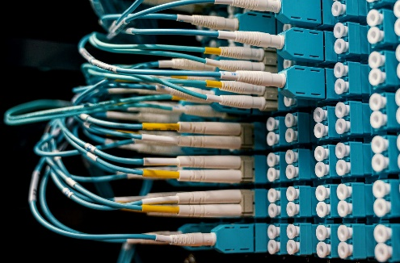
‹#›
Topic 2: Producing a preliminary ICT network architecture design
© 2022 Milestones International College

Slide 18
‹#›
TECHNICAL REQUIREMENTS ACCORDING TO SPECIFICATIONS
Once a client has confirmed that the requirements have been correctly identified and a solution has been approved, then the next step will be to ascertain the technical requirements, according to the specifications.
Topic 2: Producing a preliminary ICT network architecture design
Topic 1: Insert topic title
© 2022 Milestones International College

Slide 19
‹#›
SELECT SOFTWARE SOLUTIONS TO SUIT BUSINESS PLATFORM
The selected software solution will be specific to the client and would need to suit the business platform.
Topic 2: Producing a preliminary ICT network architecture design
Topic 1: Insert topic title
© 2022 Milestones International College

Slide 20
‹#›
ACTIVITY: READ AND DISCUSS
Read this brief definition of compatibility.
Article: https://whatis.techtarget.com/definition/compatibility
Consider why compatibility is important in terms of software solutions for a business and do some research too to find out some common approaches for resolving compatibility issues.
Topic 2: Producing a preliminary ICT network architecture design
© 2022 Milestones International College

Slide 21
‹#›
DEVELOP PRELIMINARY PHYSICAL NETWORK DIAGRAMS
A physical network diagram provides a visual representation of the IT environment and can be used to make decisions for modifications upgrades or expansions as well as providing a preface for the architecture blueprint.
Topic 2: Producing a preliminary ICT network architecture design
Topic 1: Insert topic title
© 2022 Milestones International College

Slide 22
‹#›
ACTIVITY: RESEARCH AND DISCUSS
What is the current Local Area Network layout at your RTO’s learning centre or room that you are using to study?
Discuss this as a group.
Topic 2: Producing a preliminary ICT network architecture design
© 2022 Milestones International College

Slide 23
‹#›
NETWORK LAYOUT DIAGRAMS
Network diagrams can be drawn using software to provide a visual understanding and record of how the network is connected.
Topic 2: Producing a preliminary ICT network architecture design
Topic 1: Insert topic title
© 2022 Milestones International College

Slide 24
‹#›
ACTIVITY: READ
Top 10 Network diagram, topology and mapping software.
A tutorial which can be used to learn Visio.
Creately is an editable online program that can be used to draw a diagram and then export into Viso or Word for example.
Topic 2: Producing a preliminary ICT network architecture design
© 2022 Milestones International College

Slide 25
‹#›
ACTIVITY: PRACTICAL
Compare at least two different network diagram software tools that can be used to create a schematic diagram of a network. Sign up for a free trial for one of the software and review the functions and tools for creating a network diagram.
Topic 2: Producing a preliminary ICT network architecture design
© 2022 Milestones International College

Slide 26
‹#›
CONFIGURATION OF IP ADDRESSES
An IP address uniquely identifies a device on an IP network and an IP addressing plan is vital to ensure there is an effective system in place for allocating, recycling, and documenting IP addresses and subnets in a network.
Topic 2: Producing a preliminary ICT network architecture design
Topic 1: Insert topic title
© 2022 Milestones International College

Slide 27
‹#›
ACTIVITY: PRACTICAL
Configure an IP address on an IP network. Your trainer/assessor will provide you with an activity.
Topic 2: Producing a preliminary ICT network architecture design
© 2022 Milestones International College

Slide 28
‹#›
POSSIBLE IMPACTS OF THE NETWORK DESIGN ON THE BUSINESS REQUIREMENTS
Produce a document on the possible impact of the network design on the business requirements.
Topic 2: Producing a preliminary ICT network architecture design
Topic 1: Insert topic title
© 2022 Milestones International College

Slide 29
‹#›
ACTIVITY: WATCH
Watch the following videos about security protocols and data encryption techniques:
https://www.youtube.com/watch?v=VYRPDmBaGcA (7:58)
https://www.youtube.com/watch?v=UJiLgUtddlM (8:31)
Consider the security protocols, standards and data encryption techniques used in a small local area network such as a home office network. Make notes on your answers and discuss your findings as a group.
Topic 2: Producing a preliminary ICT network architecture design
© 2022 Milestones International College

Slide 30
‹#›
ACTIVITY: GROUP WORK
Divide into small groups. Ensure you divide the work equally.
Your group is to draw a network diagram using one of the software researched.
Topic 2: Producing a preliminary ICT network architecture design
© 2022 Milestones International College

Slide 31

‹#›
Topic 3: Evaluating the preliminary design and likely performance using forecast demands
© 2022 Milestones International College

Slide 32
‹#›
PREDICT FORECAST TRAFFIC DEMANDS AND IMPACTS
When planning to change any ICT infrastructure, the current and future demand requirements of the client and their business must be taken into consideration.
Topic 3: Evaluating the preliminary design and likely performance using forecast demands
Topic 1: Insert topic title
© 2022 Milestones International College

Slide 33
‹#›
ACTIVITY: READ
The next generation functionality for the local area network.
Article: https://planetechusa.com/blog/local-area-network-lan-next-generation-functionality/
Take any notes to summarise what you have read and keep for future reference.
Topic 3: Evaluating the preliminary design and likely performance using forecast demands
© 2022 Milestones International College

Slide 34
‹#›
PREDICT FORECAST TRAFFIC DEMANDS AND IMPACTS
Traffic forecasting tools can be used to plan and estimate for future traffic based on the projected growth of the current measured or simulated traffic. This can help determine the impact of the new traffic on the network and plan for future demands.
Topic 3: Evaluating the preliminary design and likely performance using forecast demands
Topic 1: Insert topic title
© 2022 Milestones International College

Slide 35
‹#›
ACTIVITY: READ
Cisco Visual Networking Index: Forecast and trends 2017-2022 White paper.
Article: https://twiki.cern.ch/twiki/pub/HEPIX/TechwatchNetwork/HtwNetworkDocuments/white-paper-c11-741490.pdf
Take any notes to summarise what you have read and keep for future reference.
Topic 3: Evaluating the preliminary design and likely performance using forecast demands
© 2022 Milestones International College

Slide 36
‹#›
ACTIVITY: REPORT
Select one of the free downloads, or use the network monitoring tools available on your own computer.
Run some tests to analyse the network traffic. Make a note of the number of users.
Document and record your results in the form of a report with structured headings for each test and the results.
What would happen if the number of users in the room trebled? Provide a clear explanation with examples and justified reasoning.
Topic 3: Evaluating the preliminary design and likely performance using forecast demands
© 2022 Milestones International College

Slide 37
‹#›
BENCHMARK THE DESIGN USING EXPECTED PERFORMANCE PARAMETERS
Network performance metrics can be used to benchmark the design using expected results or parameters.
Topic 3: Evaluating the preliminary design and likely performance using forecast demands
Topic 1: Insert topic title
© 2022 Milestones International College

Slide 38
‹#›
MEASURING LATENCY
For a planned install of voice or an application that relies on real time video transmission, the current performance can predict if this would be possible or if an upgrade is required.
Topic 3: Evaluating the preliminary design and likely performance using forecast demands
Topic 1: Insert topic title
© 2022 Milestones International College

Slide 39
‹#›
ACTIVITY: READ
Measure network latency.
Article: https://au.pcmag.com/it-watch/57995/measure-your-network-latency-before-it-becomes-a-problem
Take any notes to summarise what you have read and keep for future reference.
Topic 3: Evaluating the preliminary design and likely performance using forecast demands
© 2022 Milestones International College

Slide 40
‹#›
BANDWIDTH AND THROUGHOUT
To measure the data transferred over a network. This can be used to ascertain the amount being used and how future growth in say number of users or use of the network will be affected.
Topic 3: Evaluating the preliminary design and likely performance using forecast demands
Topic 1: Insert topic title
© 2022 Milestones International College

Slide 41
‹#›
ACTIVITY: READ
What is network throughput and how to measure and monitor it.
Article: https://www.ittsystems.com/network-throughput/
Take any notes to summarise what you have read and keep for future reference.
Topic 3: Evaluating the preliminary design and likely performance using forecast demands
© 2022 Milestones International College

Slide 42
‹#›
UPTIME
Hardware and software metrics such as CPU utilisation, memory use, remaining hard drive space, using the network monitor to track services and software.
Topic 3: Evaluating the preliminary design and likely performance using forecast demands
Topic 1: Insert topic title
© 2022 Milestones International College

Slide 43
‹#›
ACTIVITY: READ
Use IPconfig on your computer to look at connectivity issues:
https://docs.microsoft.com/en-us/windows-server/administration/windows-commands/ipconfig
Take any notes to summarise what you have read and keep for future reference.
Topic 3: Evaluating the preliminary design and likely performance using forecast demands
© 2022 Milestones International College

Slide 44
‹#›
ACTIVITY: READ
Find out more about performance parameters at:
https://solutionsreview.com/network-monitoring/network-performance-metrics-7-essential-network-metrics-to-monitor/
Take any notes to summarise what you have read and keep for future reference.
Topic 3: Evaluating the preliminary design and likely performance using forecast demands
© 2022 Milestones International College

Slide 45
‹#›
ACTIVITY: WATCH
Summarise the security protocols, standards and data encryption techniques used in a small local area network such as a home office network.
The trainer/assessor will facilitate a discussion about the outcomes from the research.
Topic 3: Evaluating the preliminary design and likely performance using forecast demands
© 2022 Milestones International College

Slide 46
‹#›
ACTIVITY: GROUP WORK
Using the website, test your own computer for packet loss.
Undertake the tasks that follow.
Topic 3: Evaluating the preliminary design and likely performance using forecast demands
© 2022 Milestones International College

Slide 47
‹#›
REVIEW THE DESIGN’S LIKELY PERFORMANCE PROFILE
Once the predicted forecast traffic demands and impacts have been made, along with the benchmarks for expected performance parameters then these should be reviewed to provide a likely performance profile.
Topic 3: Evaluating the preliminary design and likely performance using forecast demands
Topic 1: Insert topic title
© 2022 Milestones International College

Slide 48
‹#›
DETERMINE THE SUPPLIER COSTS
Determining the costs involved with purchasing supplier products will be dependent on a number of factors:
The client budget.
The current infrastructure.
If the client specifies the vendor to be used.
The quality of supplier products required.
When the supplier products are needed.
Topic 3: Evaluating the preliminary design and likely performance using forecast demands
Topic 1: Insert topic title
© 2022 Milestones International College

Slide 49
‹#›
ACTIVITY: GROUP WORK
Divide into small groups. Ensure you divide work equally.
Research at least two suppliers that could be used to purchase equipment for building a new WLAN for a client.
Undertake the tasks that follow.
Topic 3: Evaluating the preliminary design and likely performance using forecast demands
© 2022 Milestones International College

Slide 50
‹#›
EVALUATION ON PREDICTED PERFORMANCE AND COSTS OF THE NETWORK ARCHITECTURE DESIGN
Finally, an evaluation report should be written to outline the information gathered on the predicted performance and costs of the network architecture design.
Topic 3: Evaluating the preliminary design and likely performance using forecast demands
Topic 1: Insert topic title
© 2022 Milestones International College

Slide 51

‹#›
Topic 4: Finalising the network design and obtaining approval
© 2022 Milestones International College

Slide 52
‹#›
REVIEWING BENCHMARKS, REQUIREMENTS AND FINAL DESIGN PROPOSED
The final stage for producing a network architecture design is to begin with a review the benchmarks, requirements and final design proposed.
Topic 4: Finalising the network design and obtaining approval
Topic 1: Insert topic title
© 2022 Milestones International College

Slide 53
‹#›
DETERMINING SUPPORT AND TRAINING
Any changes to the network, including upgrades, new components, systems or installation of further equipment may require support and training for staff and users of the system.
Topic 4: Finalising the network design and obtaining approval
Topic 1: Insert topic title
© 2022 Milestones International College

Slide 54
‹#›
ACTIVITY: READ
Read the best change management tools of 2022.
Article: https://thedigitalprojectmanager.com/change-management-tools/
Read the article below on skills gap analysis.
Article: https://www.cleverism.com/lexicon/skills-gap-analysis/
Topic 4: Finalising the network design and obtaining approval
© 2022 Milestones International College

Slide 55
‹#›
ACTIVITY: RESEARCH AND DISCUSS
What training would each member of the class require if a new WLAN were to be installed?
The trainer/assessor will facilitate a discussion about the outcomes from the research.
Topic 4: Finalising the network design and obtaining approval
© 2022 Milestones International College

Slide 56
‹#›
OBTAINING THE LATEST TECHNICAL SPECIFICATIONS AND PRICING
It is important to ensure that the latest technical specifications and pricing has been sourced to ensure the most up-to-date information on hardware and software being purchased.
Topic 4: Finalising the network design and obtaining approval
Topic 1: Insert topic title
© 2022 Milestones International College

Slide 57
‹#›
ACTIVITY: REFLECT AND DISCUSS
Visit a supplier website and look at the technical specifications for three network components for purchase. What is the process for contacting the vendor? What are the specs and pricing? Now look at another vendor and make a comparison. What sets the two vendors apart? Is it the shipping, time to ship, guarantee/warrantee, price or features of the components?
Topic 4: Finalising the network design and obtaining approval
© 2022 Milestones International College

Slide 58
‹#›
DOCUMENTING THE NETWORK DESIGN AND PRESENTING DOCUMENTATION
Documenting the network design and presenting the documentation for approval should be done so according to the project management guidelines, organisational requirements/policies and procedures or in a professionally structured format that is clear and easy to understand for the client.
Topic 4: Finalising the network design and obtaining approval
Topic 1: Insert topic title
© 2022 Milestones International College

Slide 59
‹#›
OBTAINING SIGN OFF ON FINAL BUSINESS SOLUTION
Signing off on a business solution will involve meeting with the client, presenting the designs and gaining approval.
Topic 4: Finalising the network design and obtaining approval
Topic 1: Insert topic title
© 2022 Milestones International College

Slide 60
‹#›
ACTIVITY: READ
See the Australian Government Contract Management Guide for an idea of what is contained in a typical contract.
Guide: https://www.finance.gov.au/sites/default/files/2020-12/Contract%20Management%20Guide%20December%202020%20-%20Master.pdf
Take any notes to summarise what you have read and keep for future reference.
Topic 4: Finalising the network design and obtaining approval
© 2022 Milestones International College

Slide 61
‹#›
ACTIVITY: RESEARCH AND DISCUSS
Source a contract template that could be used for a client to approve an ICT network architecture design.
The trainer/assessor will facilitate a discussion about the outcomes from the research.
Topic 4: Finalising the network design and obtaining approval
© 2022 Milestones International College

